Slide 1

Applying for a Federal Government Job

Slide 2
Government Jobs for Economics Majors
Actuaries
Budget Analysts
Contract Specialists
Economists
Financial Analysts
Financial Institution Examiners
Government Accountability Office (GAO) Analyst
Loan Specialists
Trade Specialists
Transportation Industrial Analysts

Slide 3
Popular government employers for Economics majors
U.S. Dept of Labor
  Bureau of Labor Statistics (BLS)
U.S. Dept of Commerce
  Including the Census Bureau, Bureau of Economic Analysis (BEA), Economics and Statistics Administration. Economic Development Administration
Independent agencies
  Federal Reserve, FDIC, Federal Trade Commission
Congressional Budget Office
However, economics majors can find jobs in nearly any area of the government

Slide 4
The Search
USAJOBS.gov: the official source
  Posts vacancy notices, or job openings
Contact agencies directly
  For assistance and information on special hiring programs
Job fairs
Networking

Slide 5
Not listed on USA JOBS:
  Legislative and judicial branch
  Intelligence agencies
  U.S. Postal Service
  Military
  Attorneys
  Foreign service workers
  Appointed positions

Slide 6
Alternate Route:
Starting in the Private Sector
Consulting firms and other employment agencies regularly place employees on contract jobs in federal agencies. These jobs, which are available in many fields, often segue into permanent federal jobs or yield networking contacts that provide inside tracks to federal jobs.

Slide 7
The Application Process:
Cover Letter
Keep it concise
  Agencies can receive hundreds of applications for a position. Make sure your cover letter is simple, to the point, and clearly conveys that you have the specific skills posted in the vacancy notice.
  Bullet points or making a two-column cover letter is appropriate, but not necessary.
Notes:
Samples? (See Hoos Career Guide)

Slide 8
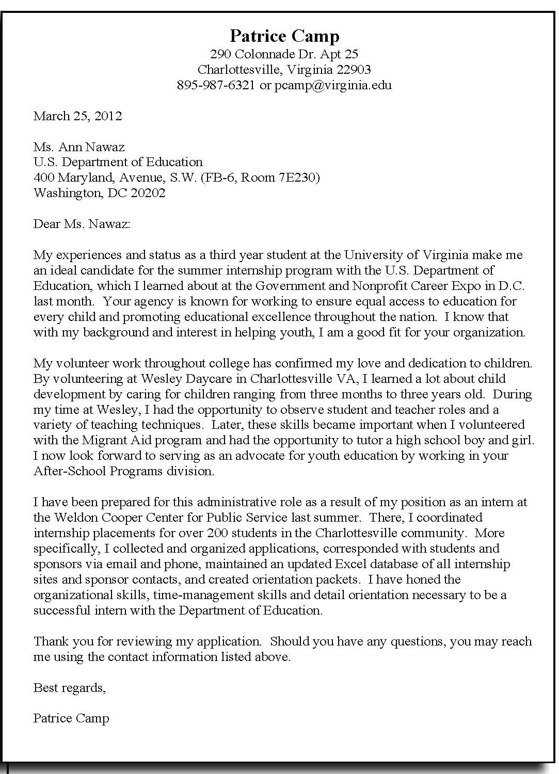
Sample Cover Letter
- from Hoos Guide, a publication of University Career Services

Slide 9
Application Process:
Resume
General Overview:
  Most agencies have agency-specific resume builders
    Often 3 to 5 pages
  Point system
    Your resume will be screened by computers and given a point value based on keywords you provide before being passed on to a hiring manager
  Beat the computers
    Be specific as possible in your resume, listing any skills and experience applicable to the job description, and include information provided in the following slides
    Use keywords from the vacancy notice as applicable

Slide 10
Application Process:
Resume
Personal Information:
  Full legal name, contact info
  Indicate veterans’ preference category (+ points)
  Indicate U.S. citizenship
    REQUIRED for most federal jobs
Objective
  = the job announcement number
Profile
  Your personal statement
Education
  High school, college name and location
  Degree awarded, date received (or expected)
  GPA

Slide 11
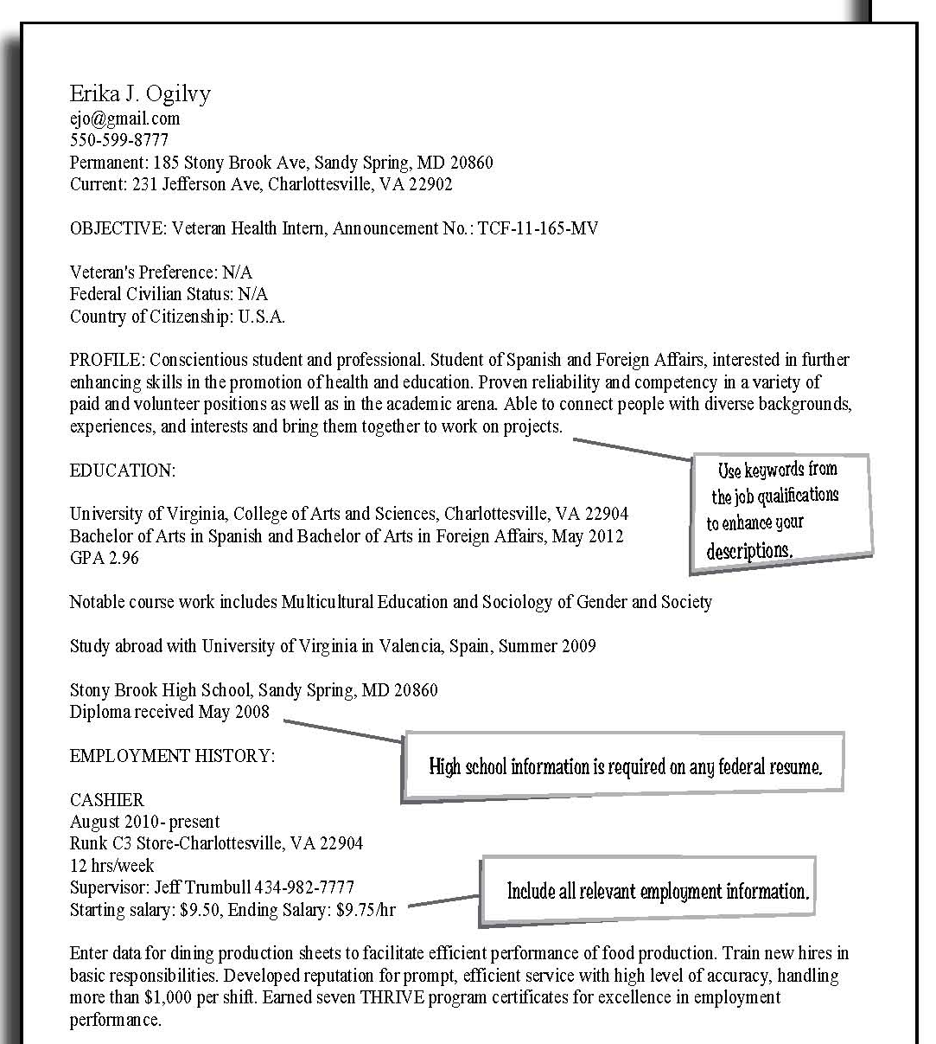
Sample Resume 1st page
- from Hoos Guide, a publication of University Career Services

Slide 12
Application Process:
Resume
Work Experience
  Job title, with employer’s name and address, and supervisor’s phone number
  Start and end dates, hours per week, salary
  Duties and Accomplishments
    Specific duties you performed (in relation to job you’re applying for) and how often
    End results of those duties
    Your role in those duties (independently, in a team, as a team leader, as a supervisor or manager)

Slide 13
Application Process:
Resume
Other Qualifications
  Skills
    Ex. Other languages, computer software/hardware, typing speed
  Current certificates and licenses
  Honors, awards and special accomplishments
    Ex. Publications, memberships in professional or honor societies, leadership activities, public speaking
  Training courses (title and year)

Slide 14
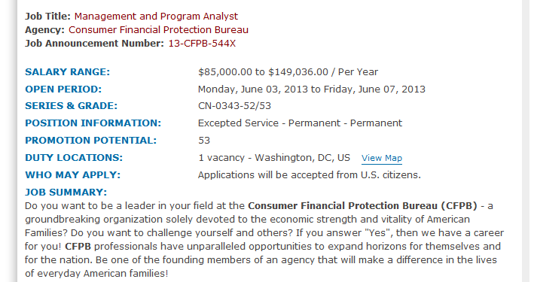
Always include…
- Job Announcement Number
- Series & Grade
- Location

Slide 15
Series Levels
The General Schedule (GS) level describes the pay scale of a government employee.
  Entry-level undergraduate positions range from GS 5-7
If the job announcement gives multiple levels, put the lowest level you would accept on your resume
Employees within different agencies may be paid under separate pay systems
  Other scales: Senior Executive Service (SES), Dept. of Veteran Affairs (VN), Federal Wage System (FWS)
  For more information, see: opm.gov/faqs/topic/employment
Notes:
What are specialized worker types? Is there a website to link to with info about the other scales and the GS scale? Please include

Slide 16
Application Process:
The KSA
= Knowledge, Skills, and Abilities Assessment
½-1 pg. written anecdotes that illustrate how you meet specific job requirements
Tips:
  Be specific. Choose multiple examples that showcase your experience
  Use a PAR statement. Problem you faced, approach you took, resolution
  Relate your experiences. If you lack certain job skills, illustrate strengths you have that are similar to the skills needed.
  Reiterate key words and phrases listed in the vacancy notice

Slide 17
Additional Materials
Questionnaires and Tests
  Listed on the vacancy announcement
  Showcase your skills, like a condensed KSA
  Often reviewed before employer looks at your resume
Other Materials
  Some agencies ask for college transcripts, writing samples, or copies of job-related certificates

Slide 18
Waiting Period
Wait at least 3 weeks after the closing date before contacting the agency
If agency has automated hiring system, check the status of your application online

Slide 19
Interview
Know the agency. Look at the website and recent press releases
Bring a photo ID to pass a security screening
Showcase your stuff. Unlike private sector jobs, which place more emphasis on your personality and future ideas for a position, government interviews place a heavy weight on past performance and experience.
Be professional while remaining personable

Slide 20
The Job Offer
Salary and Benefits: always ask if the job offer is negotiable
  Given your experience and qualifications, salary can range within a GS series level
  Government job offers can include student loan repayments, signing bonuses, and alternative work schedules
Ask for time to consider the offer against other job offers
Remember to attend the U.VA. Government and Non-Profit Career Expo at Georgetown in February!

Slide 21
Special Programs
Internship Program – usajobs.gov/studentsandgrads
  For high school and undergraduate college students
Recent Graduate Program
  For < 2 year graduates of any trade, college or professional degree
Presidential Management Fellows (PMF) Program – pmf.gov
  Leadership development for advanced degree (Masters, Ph.D.) candidates
  More competitive
  Administered by the Office of Personnel Management

Slide 22

Move on up…to your first government job!

